Slide 1

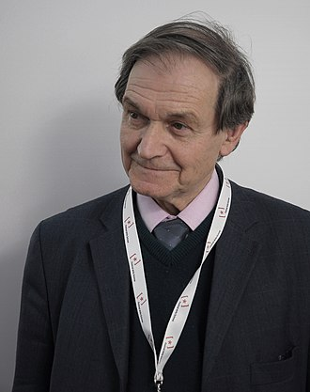
Physics Presentation
Nobel Laureate-
Roger Penrose (8 August 1931 - Present)
.

Slide 2
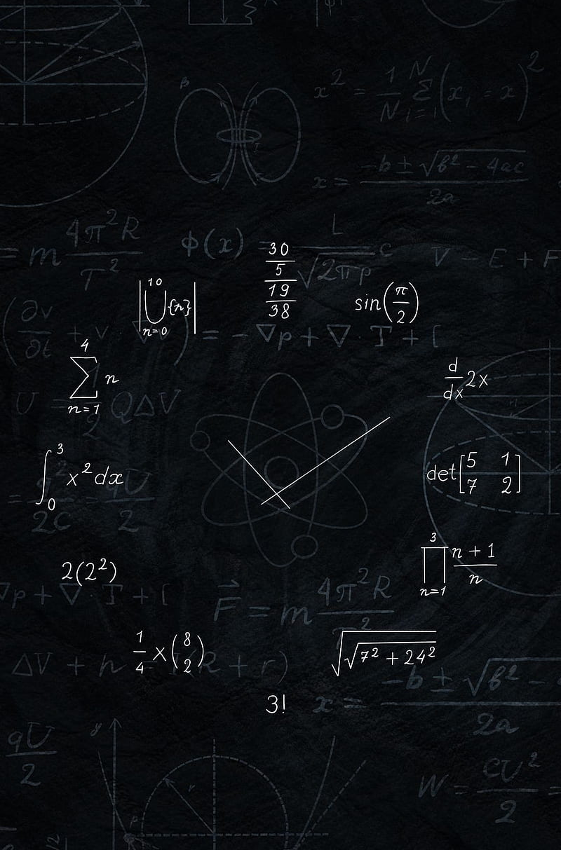
1.Early Life 2.Education
3.Research Area 4.Recent Development 5.Awards and Achievement
INDEX

Slide 3
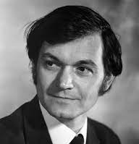
Early Life
Born on 8th August 1931 in Colchester, England, UK.
Roger Penrose is a son of Margaret (Leathes) and psychiatrist and geneticist Lionel Penrose.
Penrose spent World War II as a child in Canada Where his father worked in London, Ontario.

Slide 4
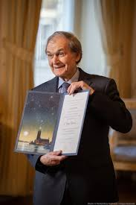
Education
Penrose studied at University College School. He attended University College London and was awarded first class degree in mathematics from University of London in 1952.
In 1955,while still a student ,Penrose reintroduced the E.H Moore generalised matrix inverse, also known as the Moore -Penrose inverse, after it had been reinvented by Arne Bjerhammer in 1951.
Having started research under the professor of geometry and astronomy, Sir W.V.D.Hodge , Penrose finished his PhD at St John’s College , Cambridge, in 1958,with a thesis on tensor methods in algebraic geometry supervised by algebraist and geometer John A.Todd.

Slide 5
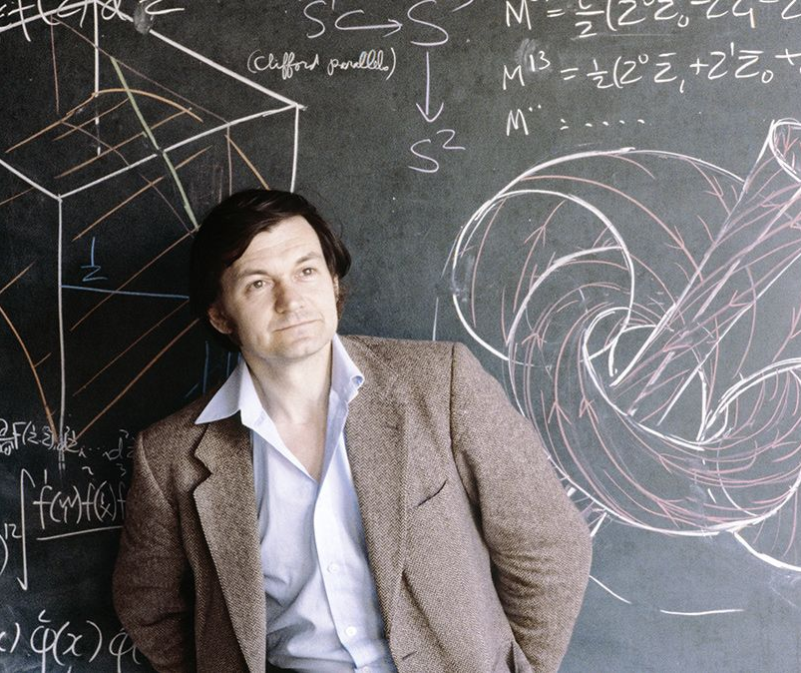
Research
Area
Penrose spent the academic year 1956–57 as an assistant lecturer at Bedford College, London and was then a research fellow at St John's College, Cambridge.
Before the fellowship ended Penrose won a NATO Research Fellowship for 1959–61, first at Princeton and then at Syracuse University.
Returning to the University of London, Penrose spent two years, 1961–63, as a researcher at King's College, London, before returning to the United States to spend the year 1963–64 as a visiting associate professor at the University of Texas at Austin.
The other, and more radically innovative, approach initiated by Penrose was to overlook the detailed geometrical structure of spacetime and instead concentrate attention just on the topology of the space, or at most its conformal structure, since it is the latter – as determined by the lay of the lightcones – that determines the trajectories of lightlike geodesics, and hence their causal relationships.
Following up his "weak cosmic censorship hypothesis", Penrose went on, in 1979, to formulate a stronger version called the "strong censorship hypothesis".

Slide 6
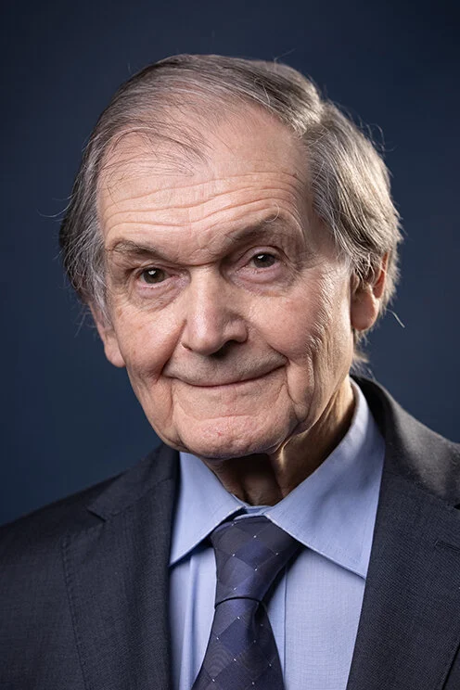
In 1967, Penrose invented the twistor theory which maps geometric objects in Minkowski space into the 4-dimensional complex space with the metric signature.
Penrose is well known for his 1974 discovery of Penrose tilings, which are formed from two tiles that can only tile the plane non periodically, and are the first tilings to exhibit five fold rotational symmetry.
In 1984, such patterns were observed in the arrangement of atoms in quasicrystals.
Another noteworthy contribution is his 1971 invention of spin networks, which later came to form the geometry of spacetime in loop quantum gravity.He was influential in popularizing what are commonly known as Penrose diagrams

Slide 7

Recent Development
Recent discoveries offer some tantalizing evidence that black holes have a dramatic influence on the neighborhoods around them - emitting powerful gamma ray bursts, devouring nearby stars, and spurring the growth of new stars in some areas.
The discovery that black hole formation is a robust prediction of the general theory of relativity, a half-share also going to Reinhard Genzel and Andrea Ghez for the discovery of a supermassive compact object at the centre of our galaxy.

Slide 8
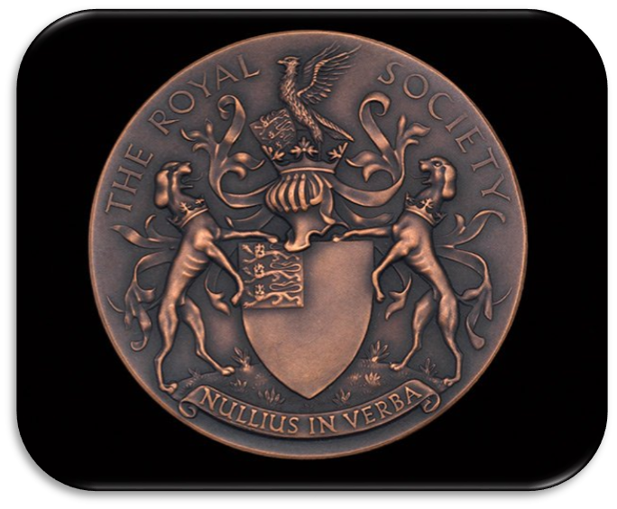
Awards and Honors
In 2020, Penrose was awarded one half of the Nobel Prize in Physics for the discovery that black hole formation is a robust prediction of the general theory of relativity.
In 2017, he was awarded the Commandino Medal at the Urbino University for his contributions to the history of science.
In 2006, he also won the Dirac Medal given by the University of New South Wales.
In 2004, he was awarded the De Morgan Medal for his wide and original contributions to mathematical physics.
Along with Stephen Hawking, he was awarded the prestigious Wolf Foundation Prize for Physics in 1988.

Slide 9

References
https://en.wikipedia.org/wiki/Roger_Penrose
https://www.nobelprize.org/prizes/physics/2020/penrose/facts/
https://mathshistory.st-andrews.ac.uk/Biographies/Penrose/

Slide 10

Efforts By:- 111032 - Selina Shrivastava 111035 - Dhriti Shah
111056- Shreerang Mhatre
111060- Aman Singh
111077- Sanat Pawar
Thank You…

